Slide 1
01 概 述 Introduction

Slide 2
数据库
Database
长期储存在计算机内的、有组织的、可共享的、互相关联的数据的集合
是一个持久数据的集合
A very large, integrated collection of data.

Slide 3
数据库管理系统
DataBase Management System(DBMS)
A software package designed to store and manage databases.
Provide efficient, reliable, convenient, and safe multi-user storage of and access to massive amounts of persistent data.

Slide 4
DBMS
Massive
Persistent
Safe
Multi-user
Convenient
Efficient
Reliable

Slide 5
Key concepts
Data model
A collection of concepts for describing data
A description of, in general, how the data is structured.
Schema versus data
A description of a particular collection of data, using the given data model
The schema sets up the structure of the database.
Data definition language (DDL)
Data manipulation or query language (DML)

Slide 6
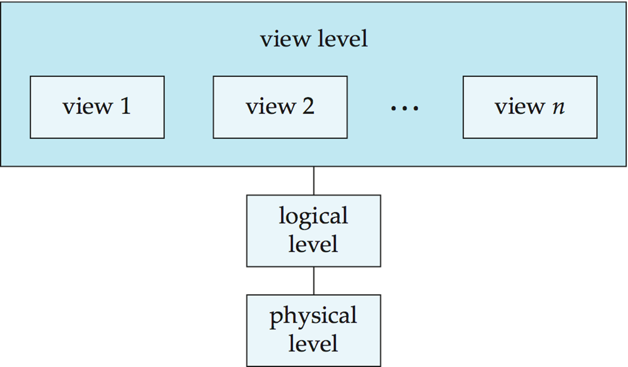
数据抽象
（Conceptual）

Slide 7
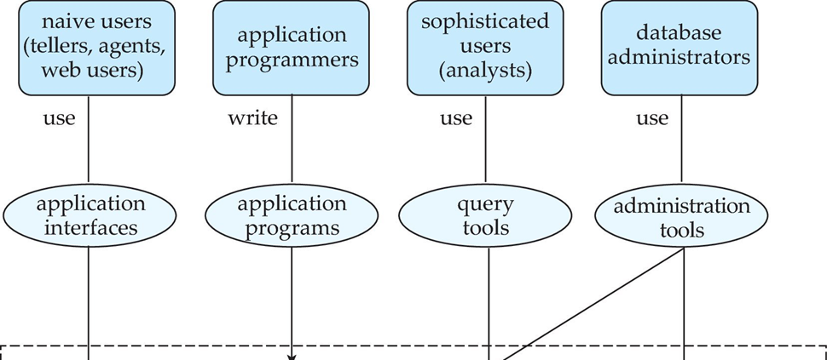
People
DBMS implementer
Database designer
Database application developer
Database administrator

Slide 8
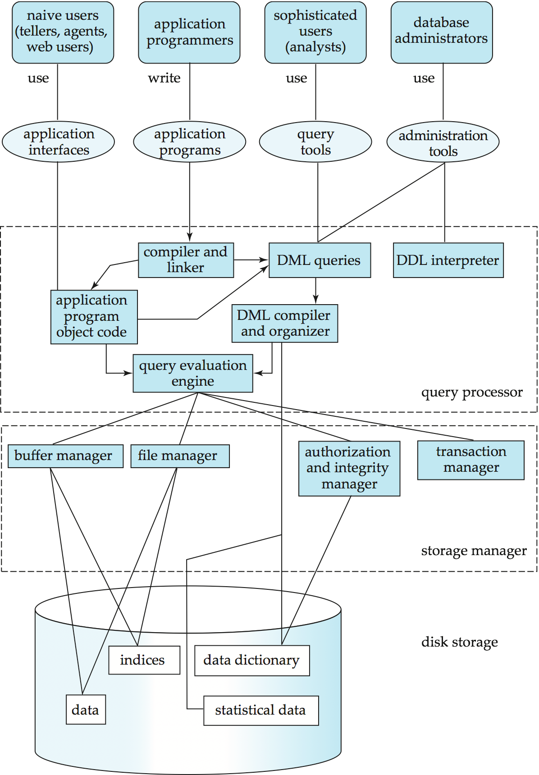
DBMS系统结构

Slide 9
数据库应用
Whether you know it or not,
you’re using a database every day
……

